Slide 1


SPE-UOB
3D
Building
2021-2022
Team members
David Zhan
Stephen Brock
Ziqing Zhang
Ruiyong Zhang

Slide 2

行业PPT模板http://www.1ppt.com/hangye/
context
Client : rich walker
This project is firstly proposed by a worker in Queen’s Building. He has been working there for years but still feel struggling while attending meetings in room he is not familiar with, which leads to the idea of this project ---- create an app which can automatically show users the path from room to room.
We have consequently concluded couple main features required for this project

Slide 3
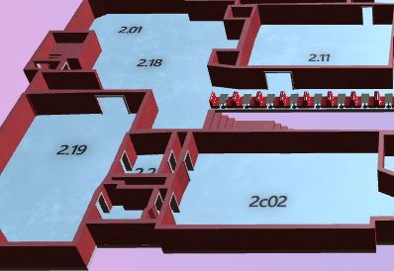
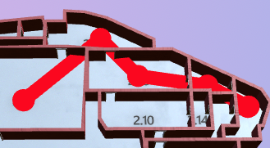
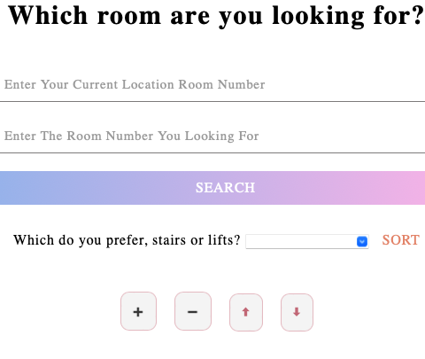
行业PPT模板http://www.1ppt.com/hangye/
context
Client : rich walker
a model that shows the structure of the building
A pathfinding algorithm which guide the user to the correct room
a neat UI that speak for itself and help used understand how to use it immediately

Slide 4

context
Client : Rich Walker
Front end
Pathfinding algo
Contributor : Ruiyong
Contributor : David
Modelling
Web hosting
Contributor : Stephen
Contributor :Ziqing

Slide 5
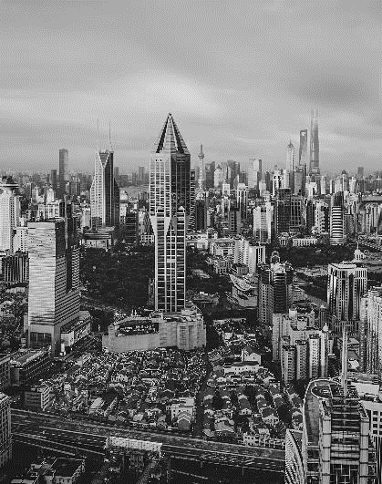
N
O
frontend
0
1

Slide 6

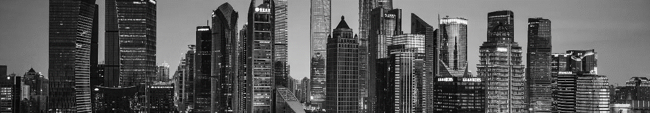
UI design
HTML used for front end
CSS is used for front end
The idea of the interface in to help user get familiar with the app
Some alert should be given if user wrongly use some button and put in invalid value

Slide 7


N
O
Pathfinding and data storing
0
2

Slide 8
Pathfinding
Data storing
1.Dijkstra algorithm
2.Do Dijkstra separately in different floors and combine them
3. Send the output of pathfinding to js code function which draw that specific path
1.Using statistic data set rather than database
2.2D array is used as matrix to store the room information

Slide 9
N
O
modelling
0
3

Slide 10
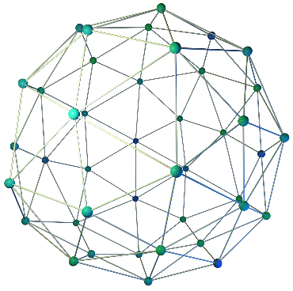
1.Use blander to assist modelling
2.Using processing 5 to model (p5.js)

Slide 11
N
O
Web hosting
0
4

Slide 12
1
Host the website on Amazon server
Create the container
(the docker file)
2
Web
Design
process
Decide to use IBM and learn how to use Kubernetes
3
4
Host the website on IBM cloud
Regularly update the newest version of project to the IBM cloud
5

Slide 13
A quick demonstration
https://group-3dbuilding.classroom-eu-gb-1-bx2-4x1-d4ceb080620f0ec34cd169ad110144ef-0000.eu-gb.containers.appdomain.cloud

Slide 14
Challenge confronted (and solution)
1. Communication
2. A lot of new things to learn
3. Unfamiliar with GitHub
4. Feedback required

Slide 15
Biggest lesson we learn
1. How to collaborate
2. How to make project through GitHub more professionally.

Slide 16
SPE-UOB
3D
Building
2021-2022
Thanks for watching!
Team members
David Zhan
Stephen Brock
Ziqing Zhang
Ruiyong Zhang

